Slide 1
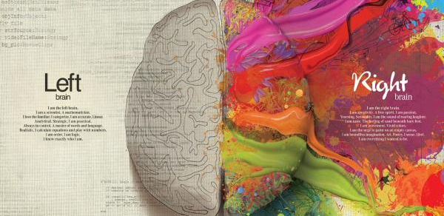
Interactive Presentation
Steven King
StevenTking.com
UNC Multimedia Bootcamp

Slide 2
Medium Choice
Questions to ask before starting
Who is the audience?
What is the story?
Is the story visual or can I make it visual?
How is this content to be consumed
What is the best place and way to present this story
Video, Text, Graphics, Photos, all the above?
Online, Social, TV, Print, Billboards, Mobile, Bus stations?

Slide 3
Online, Mobile and Social
Class will focus on presenting your content for online and mobile audiences.
Interactive Design
HTML
CSS
AJAX
Graphing/Mapping

Slide 4
Design Basics
Interactive Bootcamp
Introduction
Color for Web
Type for Web
Web Layout

Slide 5
CRAP Design
C.R.A.P:
Contrast
Repetition
Alignment
Proximity

Slide 6


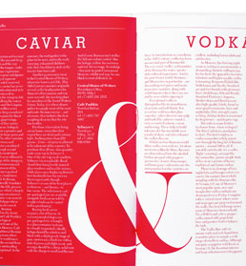
Contrast
Use colors, shapes, sizes, fonts, space and imagery to create contrast in design.
Avoid colors and typefaces that are similar.

Slide 7
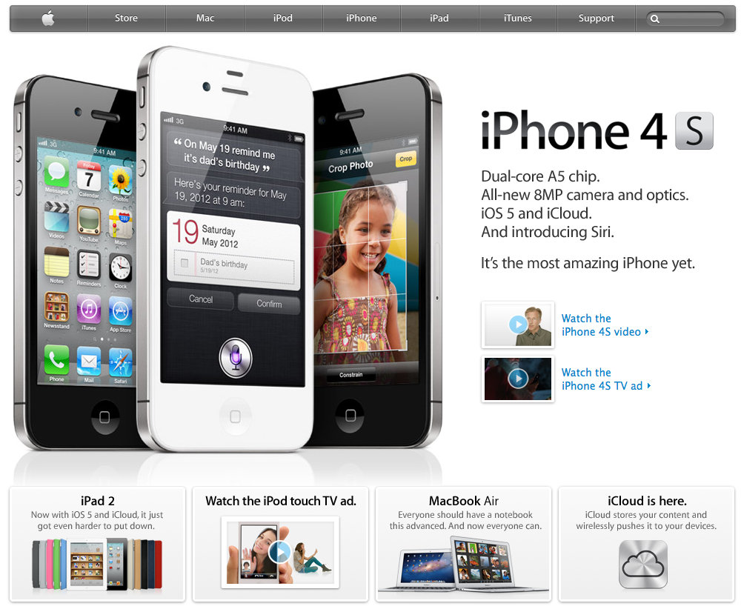

Slide 8

Repetition
Repeat visual elements throughout the design
Communicates consistency and brand

Slide 9
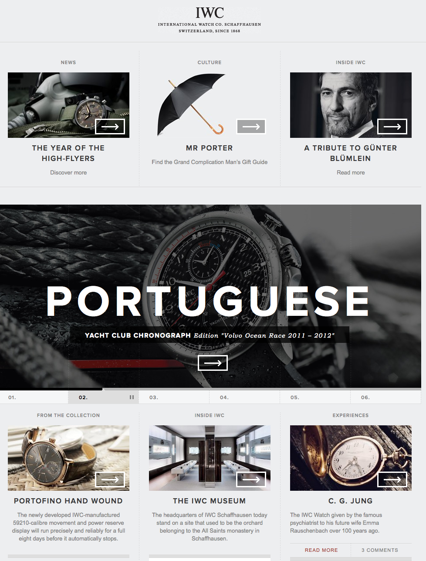

Slide 10


Alignment
Where’s my boat?
Dock 4, Slip 20.

Slide 11
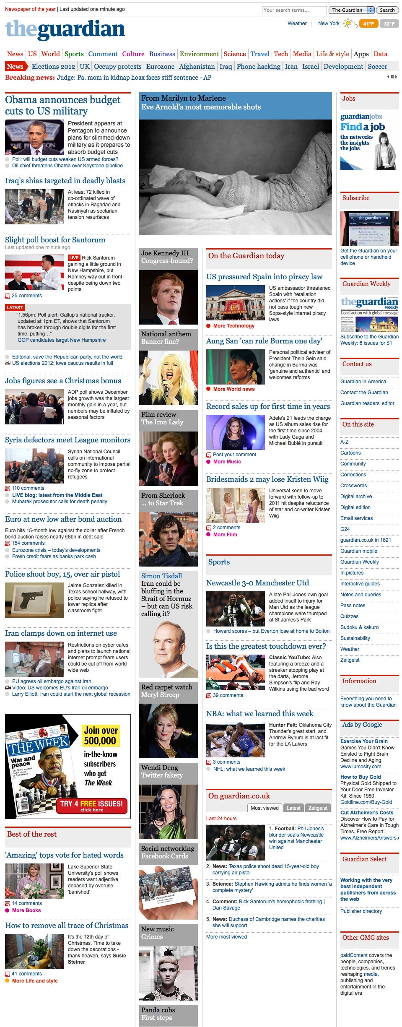

Slide 12
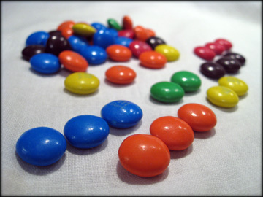

Proximity
Similar Items Closer, Different farther apart.

Slide 13
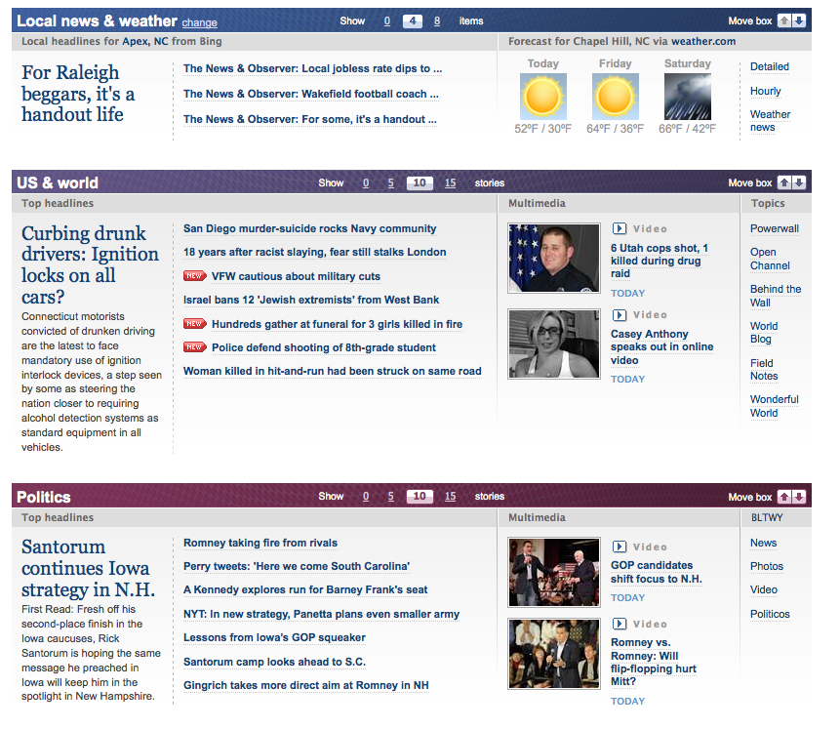

Slide 14

Color

Slide 15
CMYK or RGB?
CMYK
RGB
For Print
Pigment
DO NOT USE IN CLASS!
For Screens
Light
ALWAYS USE IN CLASS!
WE WILL NEVER USE OR SPEAK OF CMYK IN THIS CLASS AGAIN!

Slide 16

Color Relationships
Complementary
Two opposite colors in wheel
Triads
Triangle Spacing around wheel
Analogous
Adjacent Hues
Monochromatic
Single color, varied intensity
Compound
Combines colors from various hues

Slide 17
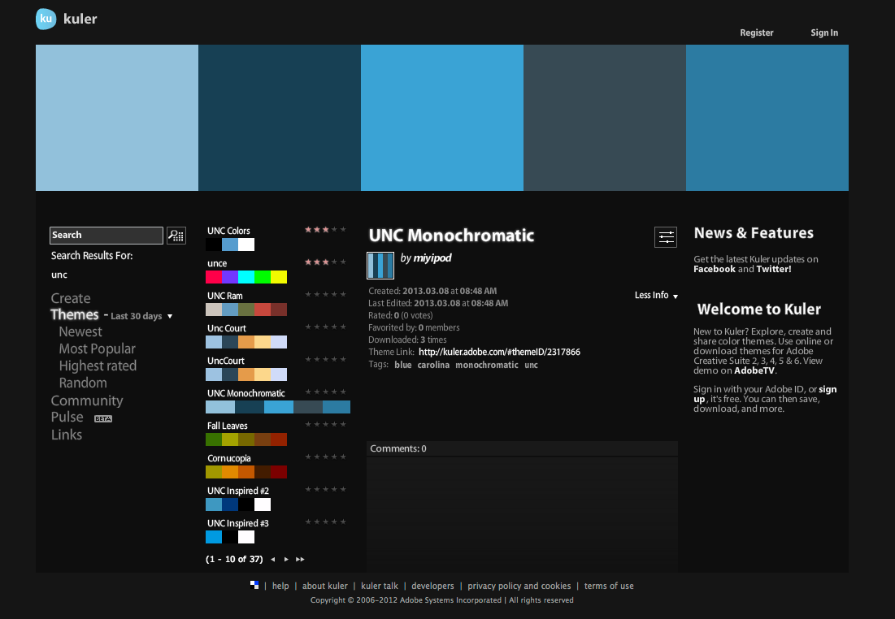
kuler.adobe.com

Slide 18

Web Type
Readability
Relationships
Types of Type (Fonts
Type on the web

Slide 19
Readability
Type has multiple purposes but the most important is readability. The ability for a reader to easily read and understand the text.
Contributors/Distractors
Size, color, texture, light, font, weight, relationship etc.

Slide 20
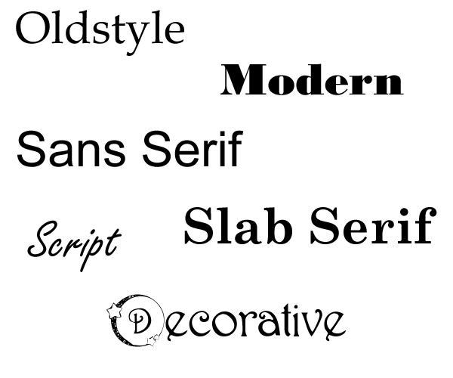
Type Categories
Remember them in groups of two:
Old/Modern, Serif/Sans, Script/Decorative

Slide 21

Type Categories

Slide 22
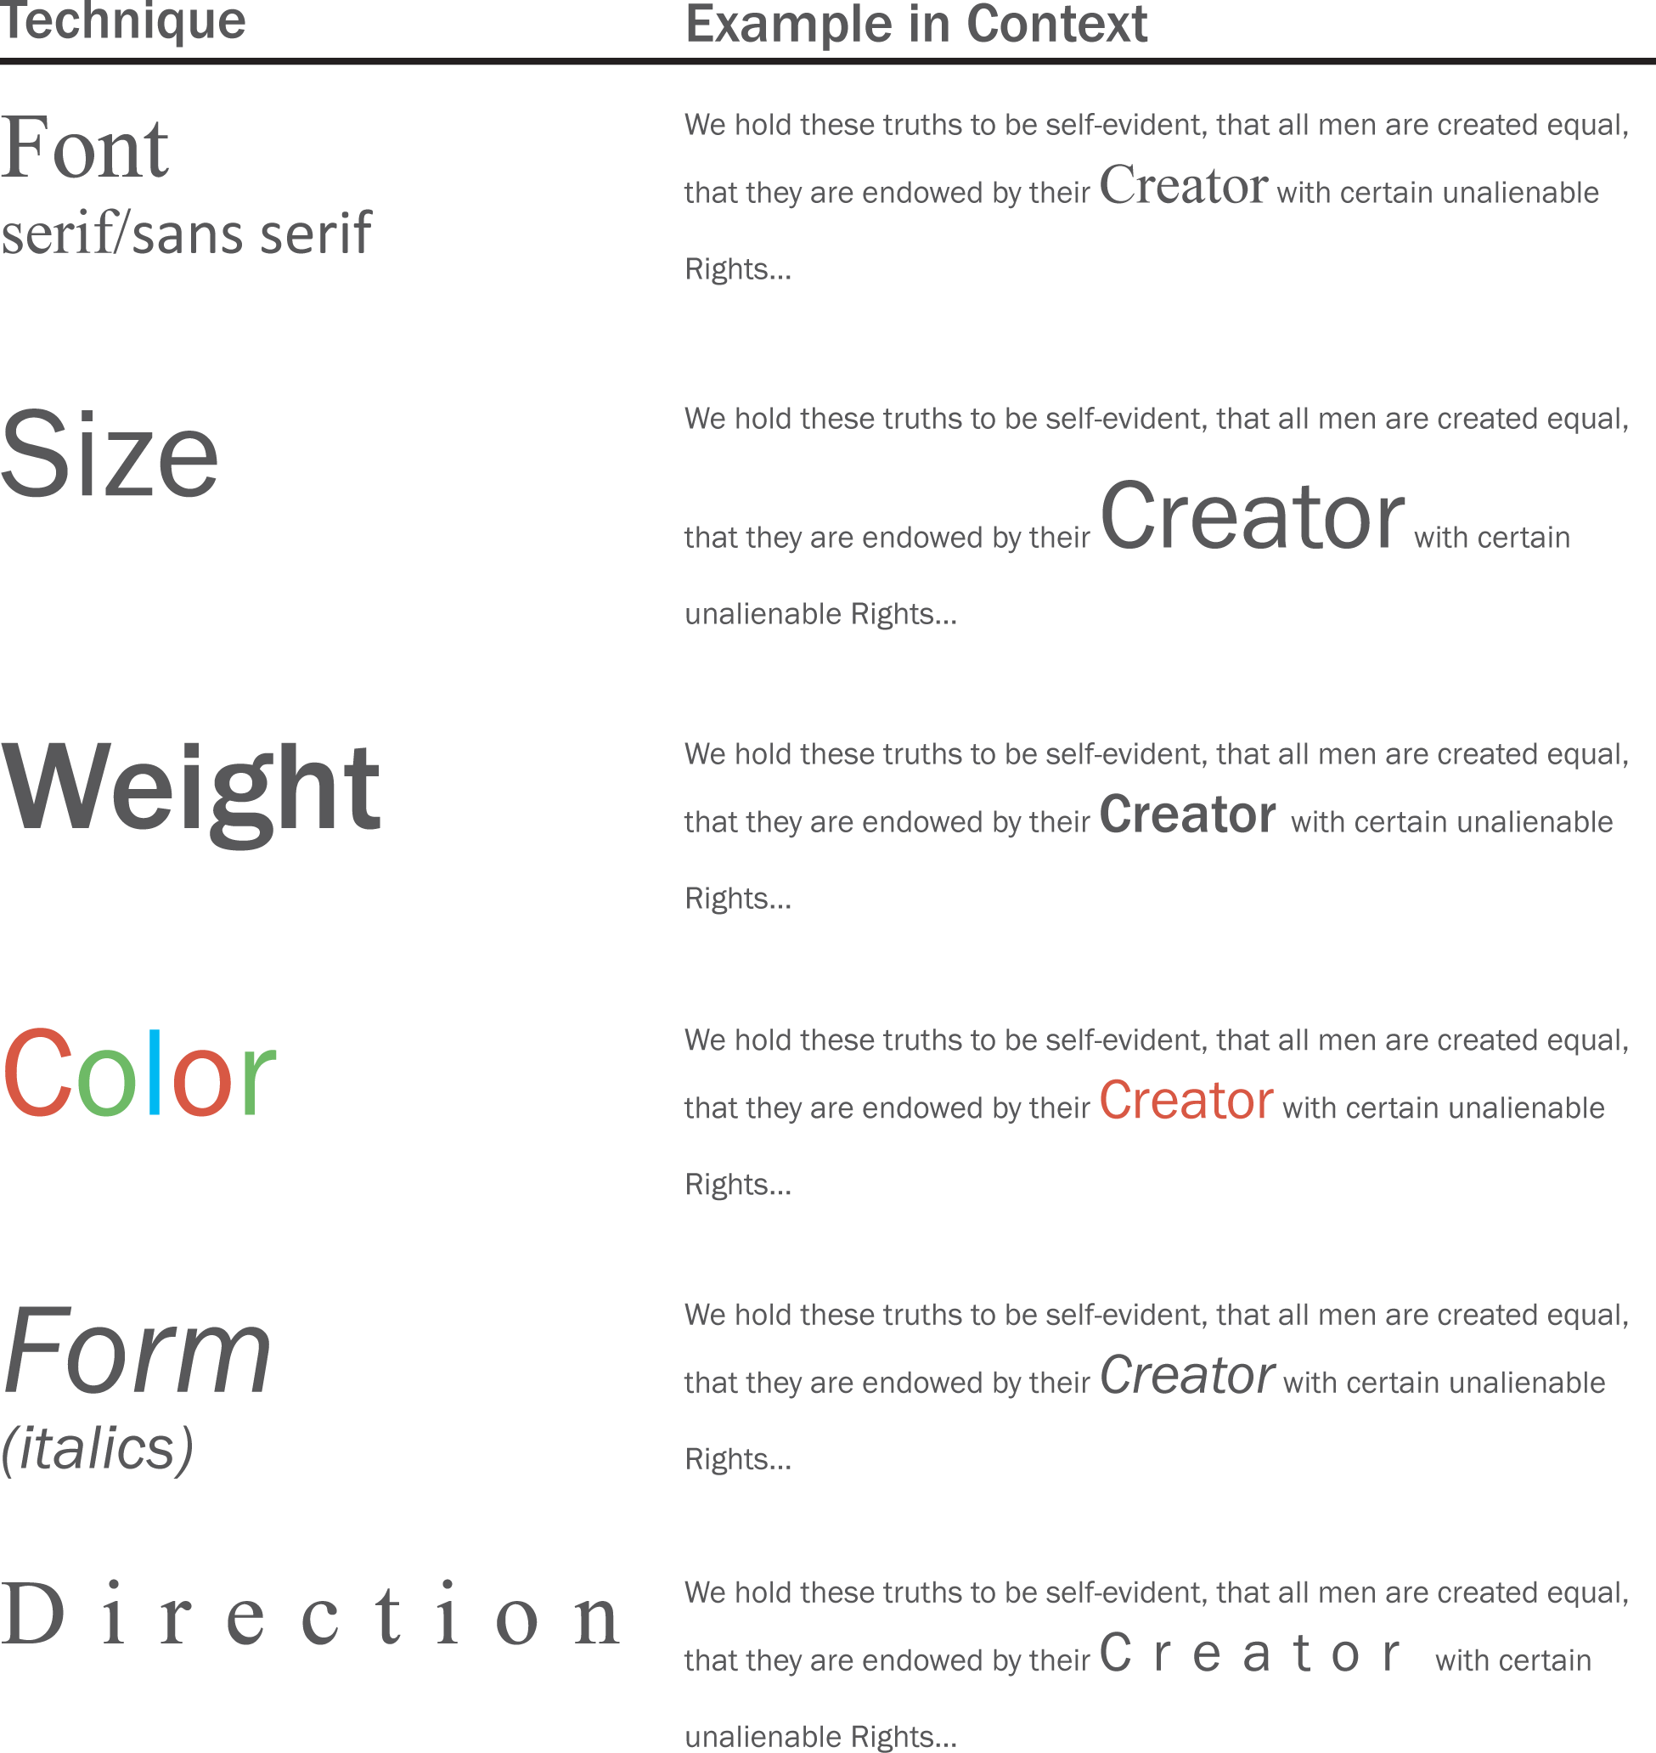

Slide 23
My Rules for Type
Never use more than three fonts and two is probably enough
Never use more than one serif font on a page
Never use more than one decorative font and only in limited doses
Typically, I choose one Serif, one san and call it a style!

Slide 24
Fun
Dafont.com
What the Font App

Slide 25
Web Layout
Rule of Thirds in Layout
Standard Web Layouts
New World
Wireframes to Comp

Slide 26
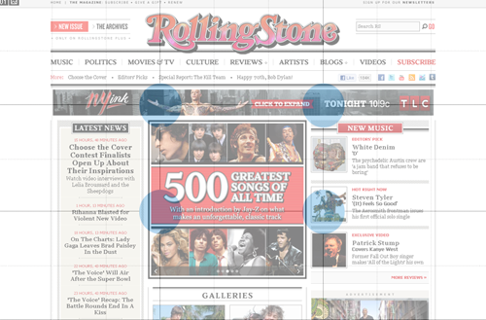
Rule of Thirds

Slide 27
Layouts: Fluid vs. Fixed Width
Fluid Changes with browser size
Fixed is static size no matter the browser window size

Slide 28
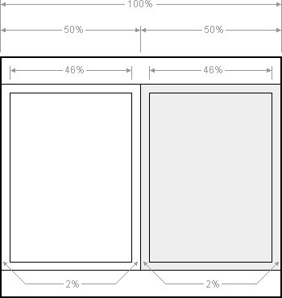
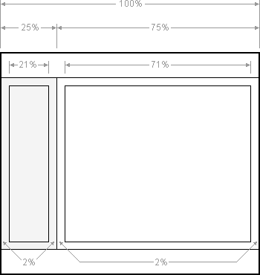
Standard Layouts
1 col
2 col
3 col

Slide 29
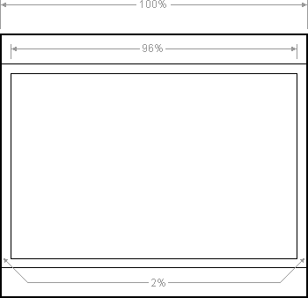
1 Column or Fluid Center

Slide 30
2 Column Fluid

Slide 31
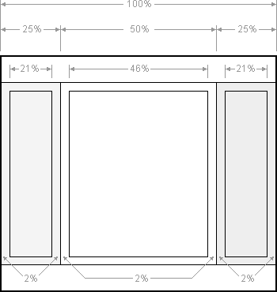
3 Column Fluid

Slide 32

Online and Mobile Design
Adaptive Design
Responsive Design
Apps vs. Websites

Slide 33
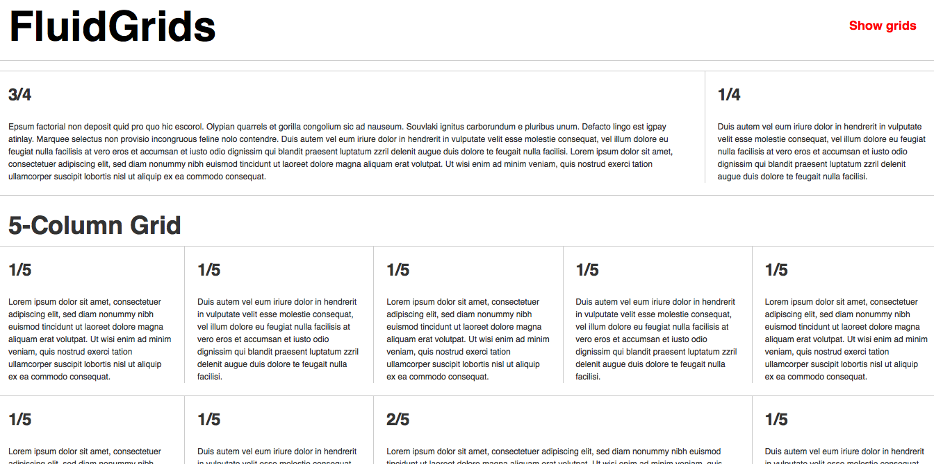
New Models
Adaptive Design
Responsive Design

Slide 34
A short history lesson

Slide 35
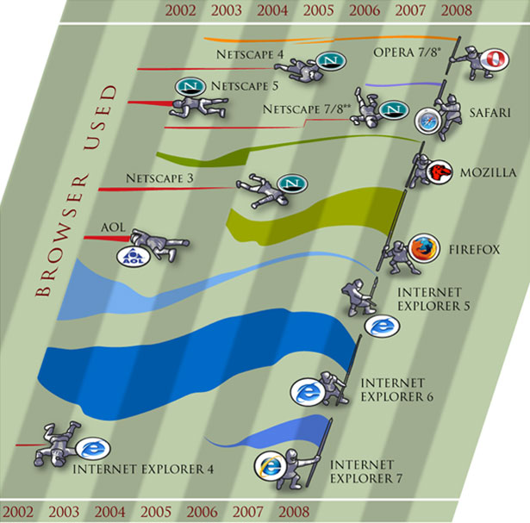
HTML and CSS
Browser Wars
Jobs assignation of Flash
HTML, XHTML, HTML5
CSS and CSS3
Browser Support ???

Slide 36
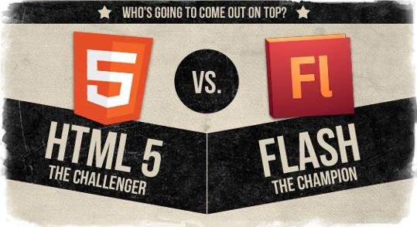
Battle has been won!
Sort of…

Slide 37

Lets get to work!

